Slide 1

Detection Of Fake Reviews on Online Review Platforms using Deep Learning Architecture
Group Number 22
Pavel Golikovski 320636574
Natan Zaitzev 312171705
Alla Davydov 317000669

Slide 2
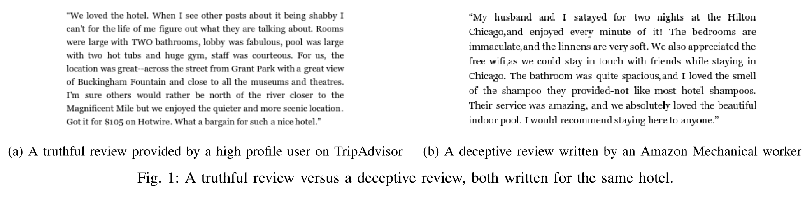
The Problem with Online Review Platforms
In the past few years, consumer review sites have become the main target of deceptive opinion spam
Fictitious opinions or reviews are deliberately written to sound authentic
Detecting and classifying whether an online review is truthful or deceptive can be solved by using Deep Learning.

Slide 3
Deep Learning Neural Networks Models:
Purpose of DNN to use known data to deduce information about new data that received, as well as replicate a model of human brain and its learning process.
The models we review:
Bi-LSTM with GloVe 50d
Bi-LSTM + Attention with GloVe 100d
CNN + Bi-LSTM with TF-IDF Doc2Vec

Slide 4
Word Embedding
Word Embedding is a language modeling technique used for mapping words to vectors of real numbers.
Representing words in a numerical format it’s a first step in building any kind of Machine Learning Model
I’ll show how to use a few NLP techniques to transform words into mathematical representations and plot them as points, it represents words or phrases in vector space with several dimensions.
TF-IDF
Doc2Vec
GLoVe

Slide 5
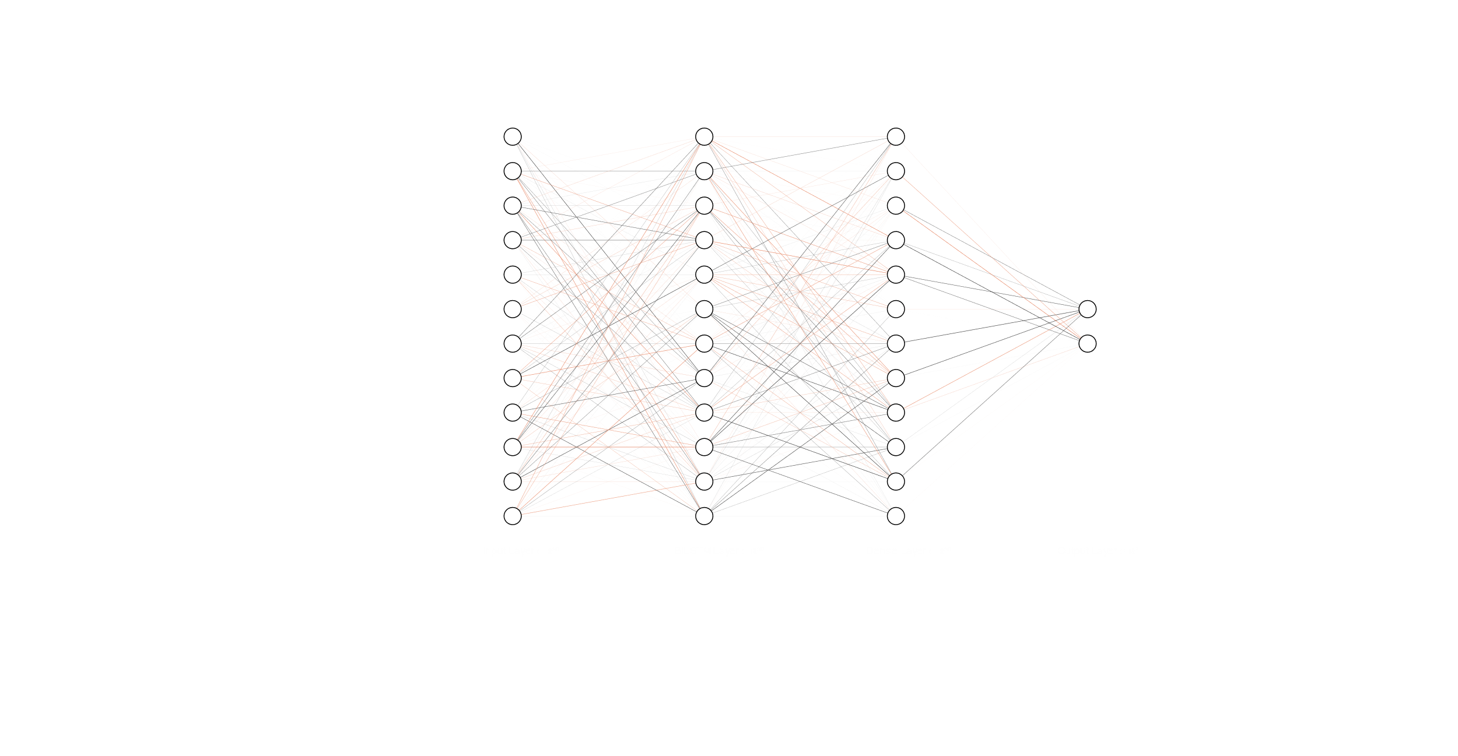
Model 1: Bi-LSTM with GloVe 50d

Slide 6
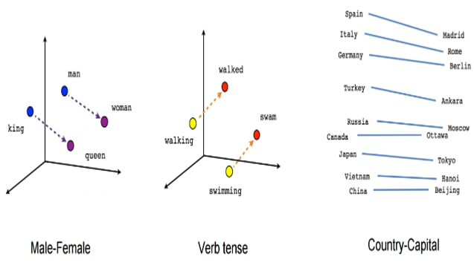
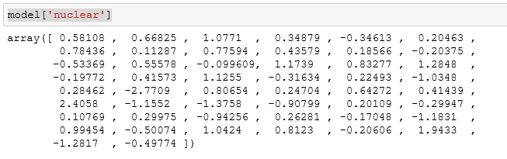
GloVe
Unsupervised learning algorithm for vector representations for words
Uses global statistics of a corpus
Words are mapped into a 50, 100, 200, 300-dimensional meaningful space
Distance between words is related to semantic similarity

Slide 7
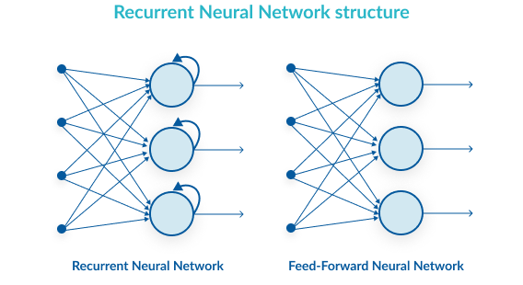
Recurrent Neural Networks
The algorithm shows behavior like how the human brain function
In a RNN the output from the previous phase is fed as input to the current phase.
The algorithm remember the information from the previous step.
Problem: Vanishing / Exploding gradient.

Slide 8
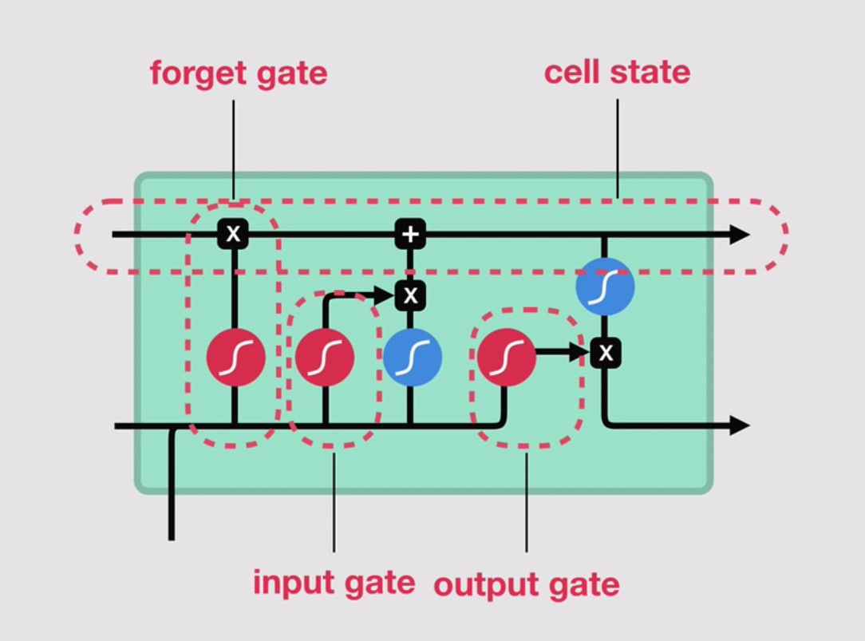
Long Short-Term Memory
The advantage of LSTM is the ability to forget the irrelevant information and remember what is important
The input the current cell is the output of the previous one and the next word vector
Uses tanh and sigmoid functions to normalize values
Each cell contains multiple gates that decide the weight of an input over the whole context.
The solution to the gradient vanishing/explosion: LSTM.

Slide 9


Activation Function
The activation function in a neural network determines how the weighted sum of the input is converted to the output of the neurons of the network layer.
1. ReLU activation Function 2. Sigmoid activation Function

Slide 10
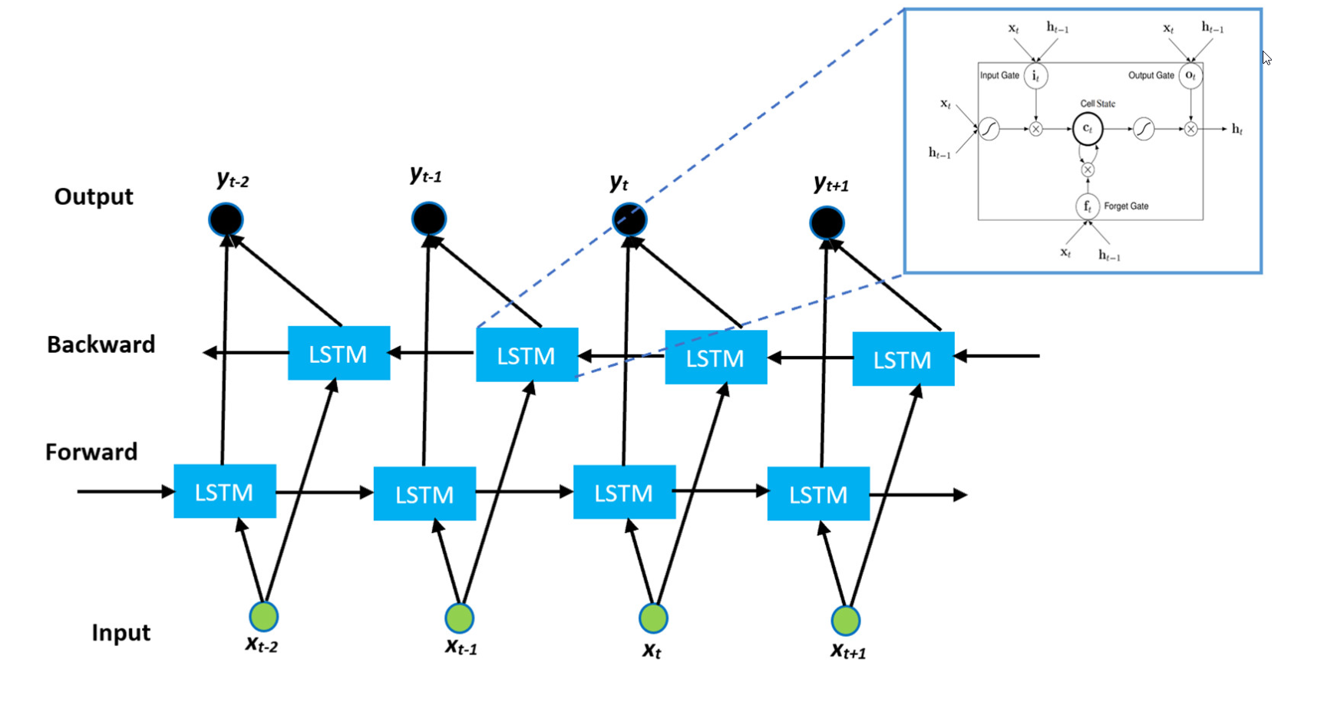
Bidirectional LSTM
Connects two hidden layers of opposite directions to the same output.
The output layer can get information from past (backwards) and future (forward) states simultaneously.
BiLSTMs show very good results as they can understand context better

Slide 11
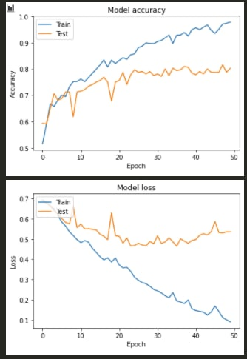
Model 1: BiLSTM with GloVe 50d
Preparation:
Truthful = 1, Deceptive = 0
Tokenize all words and limit a review length to 150
Pad all reviews to length of 150
Divide reviews to 80% training and 20% testing sets
Embed words using GloVe with 50 dimensions
Neural Network:
Embedding
Input
Bidirectional LSTM (50)
GlobalMaxPool
Dense (50, relu)
Dropout (0.1)
Dense (2, sigmoid)
Results:
loss: 0.5354 - accuracy: 0.8031

Slide 12
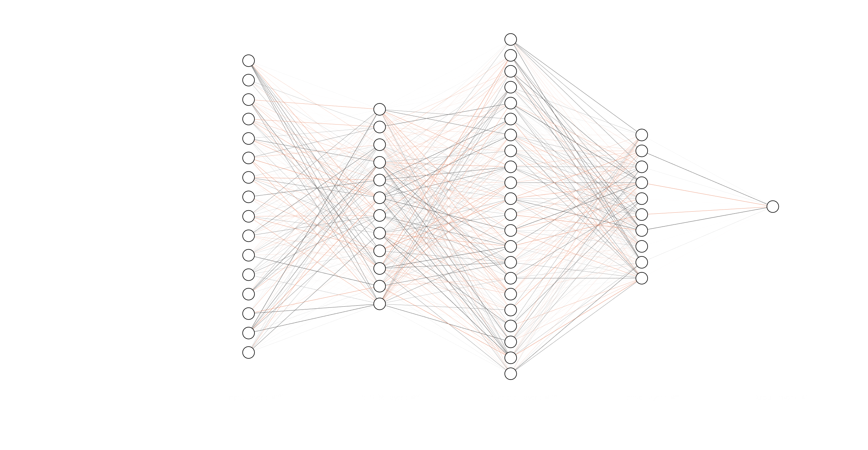
Model 2: Bi-LSTM + Attention with GloVe 100d

Slide 13
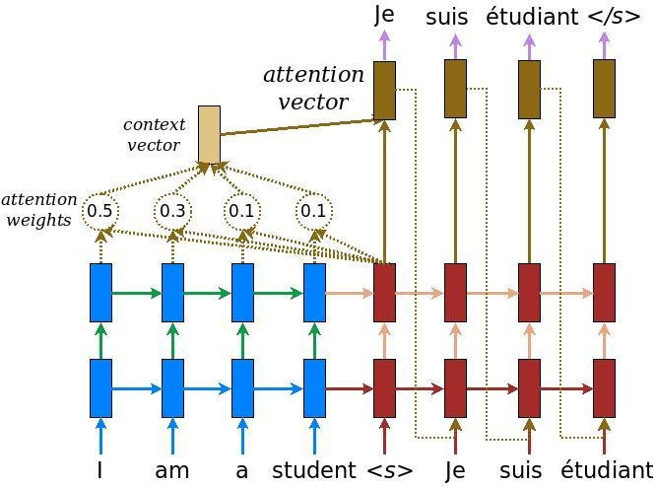
Attention Layer
Attention Mechanism is an attempt to implement the action of selectively concentrating on a few relevant things, while ignoring others in deep neural networks.
The algorithm attempts to find keywords that are most contributing towards the final classification, lowering weights of the words that don’t, hence, refining the feature vector.

Slide 14
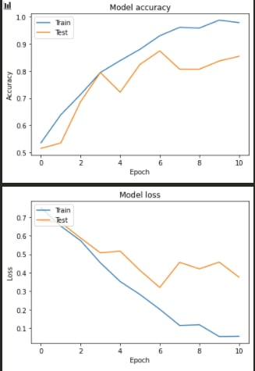
Model 2: Bi-LSTM + Attention with GloVe 100d
Preparation:
Truthful = 1, Deceptive = 0
Preprocess the text
Tokenize all words and set the max review size to 415 (avg + std * 3)
Pad all reviews to fit a 415 shape
Embed words using GloVe with 100 dimensions
Neural Network:
Input
Embedding
Bidirectional LSTM (60)
Dropout (0.3)
Attention
Repeat 2-5
Concatenate
Dense (50, relu)
Dropout (0.2)
BatchNormalization
Dense (1, sigmoid)
Results:
loss: 0.3762 - accuracy: 0.8550
A 6.4% improvement.

Slide 15
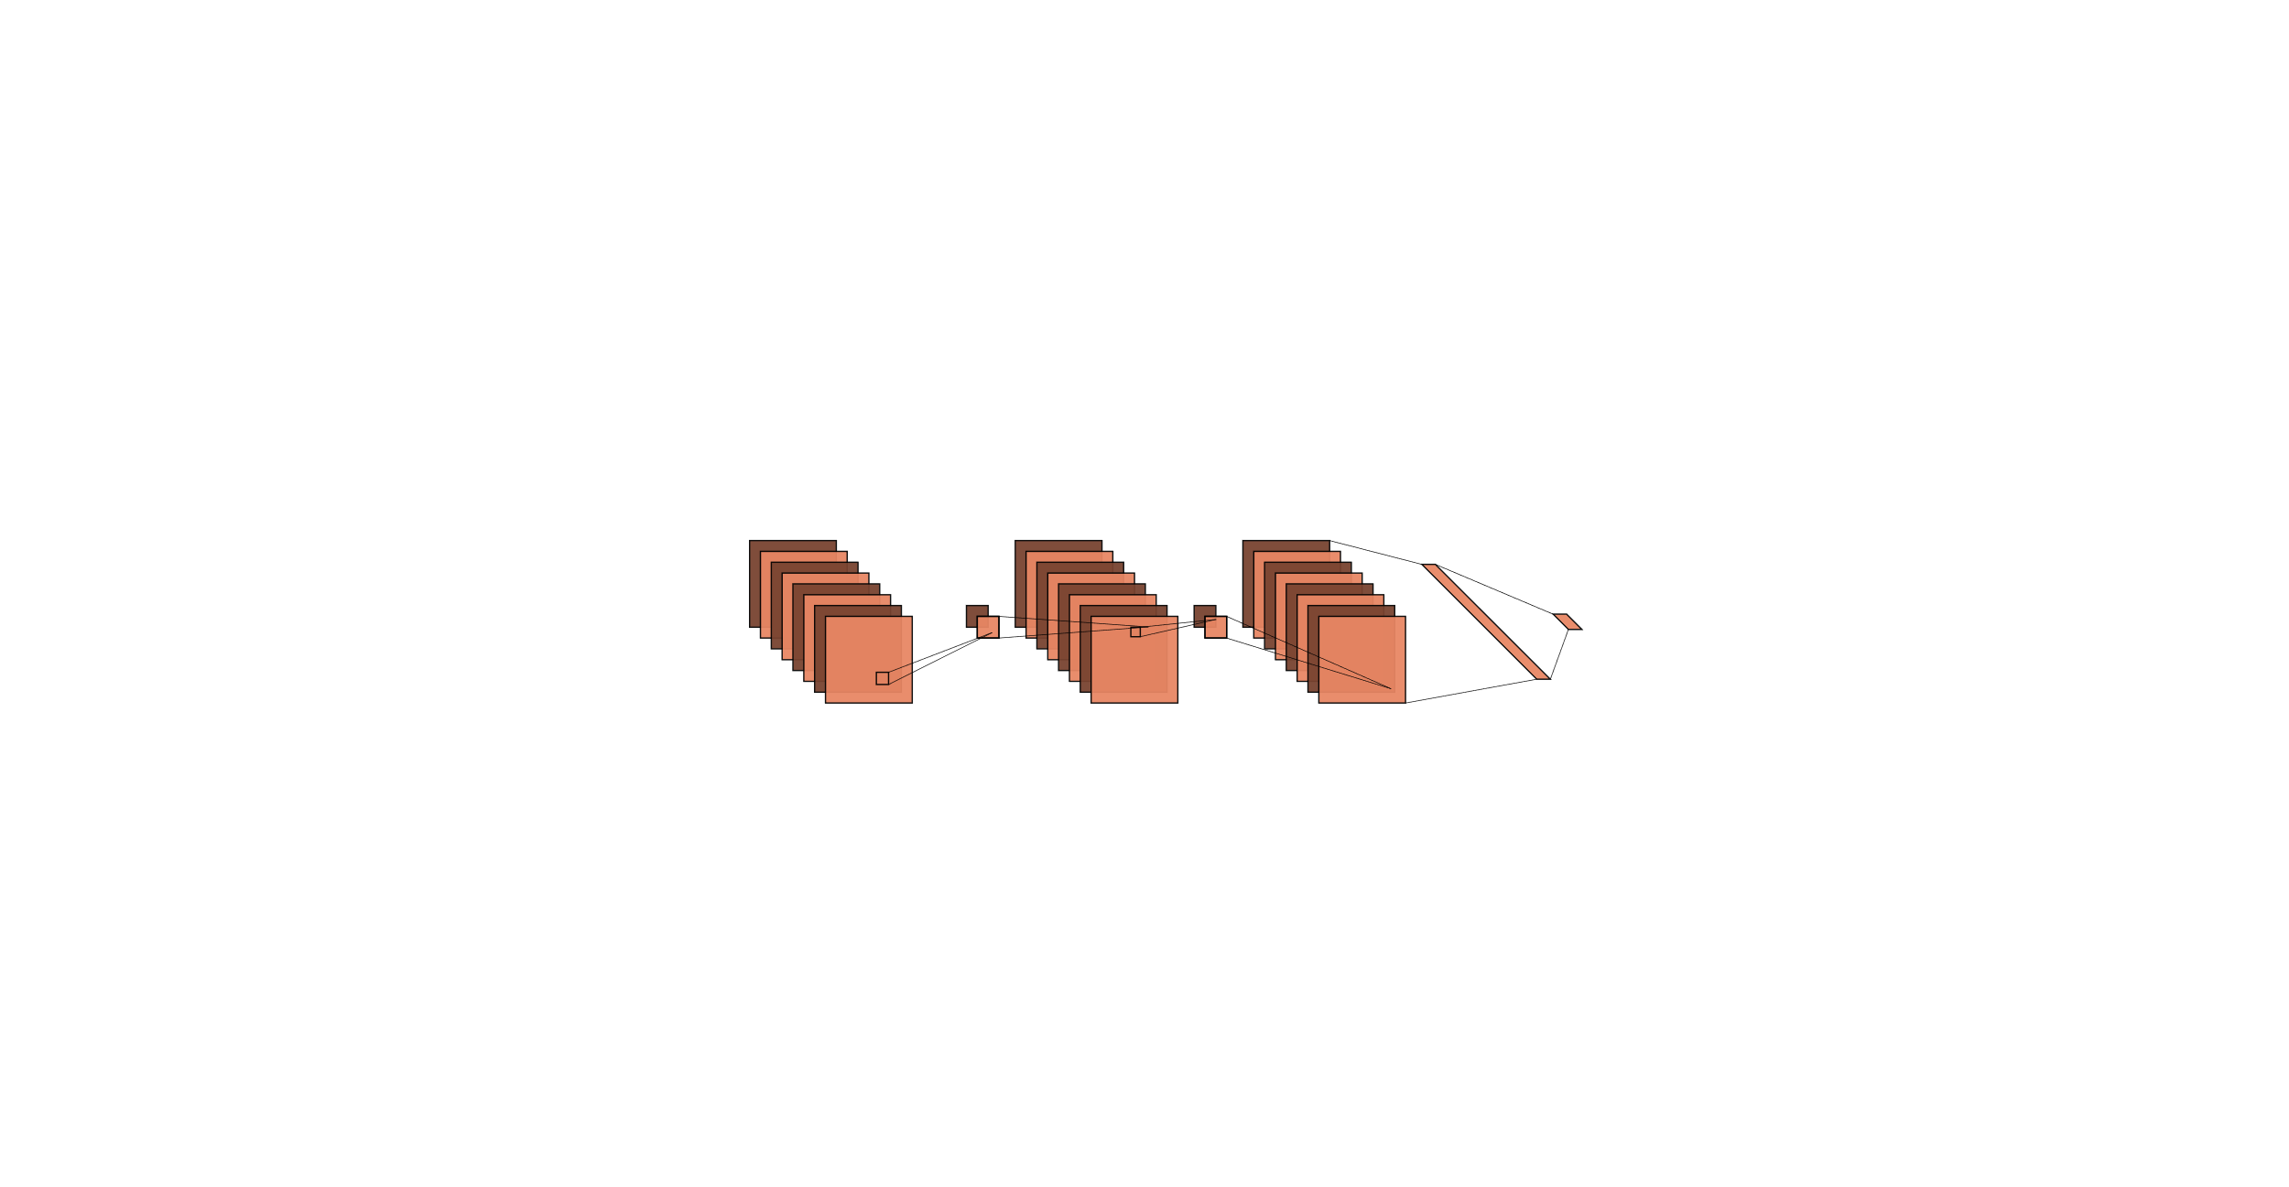
Model 3: CNN + Bi-LSTM using TF-IDF+Doc2Vec

Slide 16
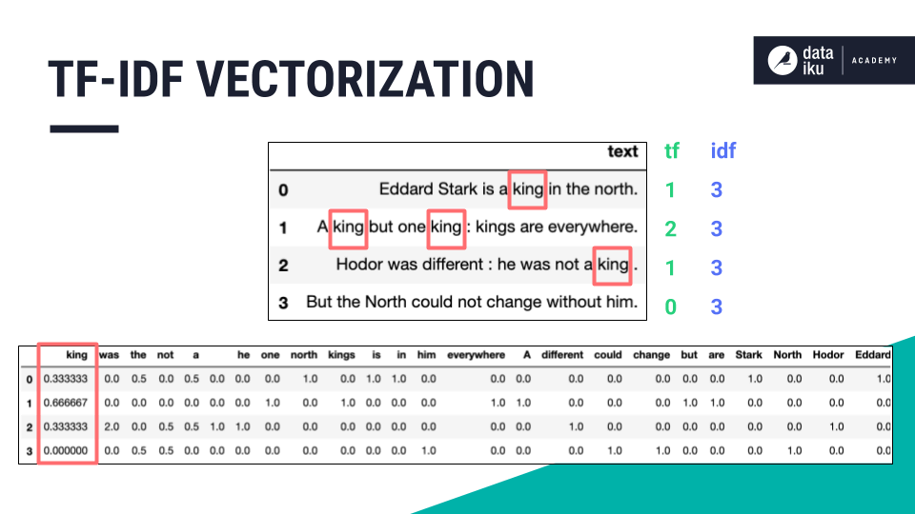
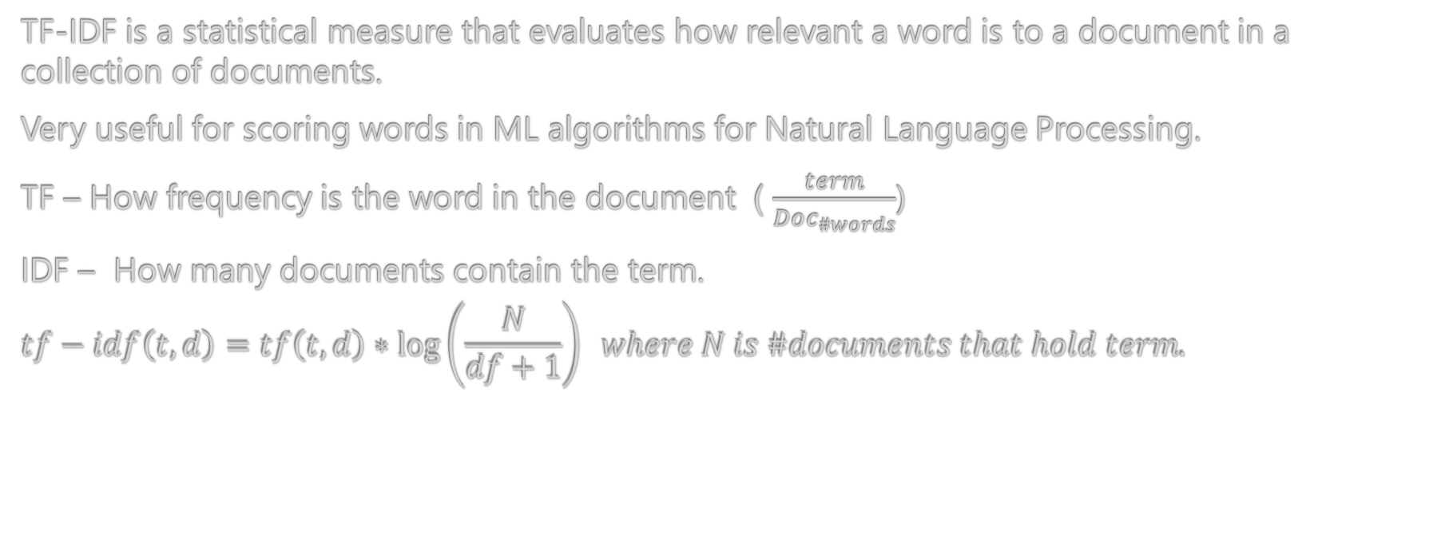
Term Frequency - Inverse Term Frequency (TF-IDF)
TF-IDF is a statistical measure that evaluates how relevant a word is to a document in a collection of documents.
Very useful for scoring words in ML algorithms for Natural Language Processing.
TF – How frequency is the word in the document ) $\frac{term}{Doc_{\#words}}$)
IDF – How many documents contain the term.
$$tf−idf\left(t,d\right)=tf\left(t,d\right)∗\log\left(\frac{N}{df+1}\right) where N is \#documents that hold term.$$

Slide 17
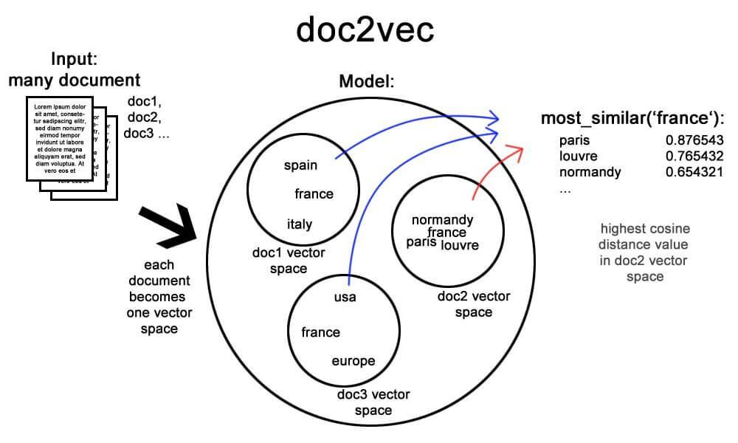
Doc2Vec
Doc2Vec learns a conceptual representation of a document from a corpus of documents
Doc2Vec tags the documents and uses them for the training phase. During the training of the model, it learns paragraph and word vectors that are a semantic representation of the documents.

Slide 18
Doc2Vec / TF-IDF - Usages
Doc2Vec
TF-IDF
Doc2Vec helps us find similarities between whole reviews.
We can establish connections between deceptive and authentic reviews using it.
TF-IDF help us find the words with higher contextual weight.
We can locate specific words that usually appear in Authentic/Fake reviews which will help us predict.

Slide 19

Convolutional Neural Network
CNN separates and identifies the various features of the input for analysis in a process called Feature Extraction
The convolutional layer provides a better semantic representation of words, It consists of many various filters.
Notes:
המודל שלנו משתמש ברשת קונבולוציה על מנת שנוכל לקבל אפיון יותר מדויק של תגובות ועל ידי כך למצוא את המאפיינים שמקשרים בין תגובות מומצאות לאמיתיות.

Slide 20
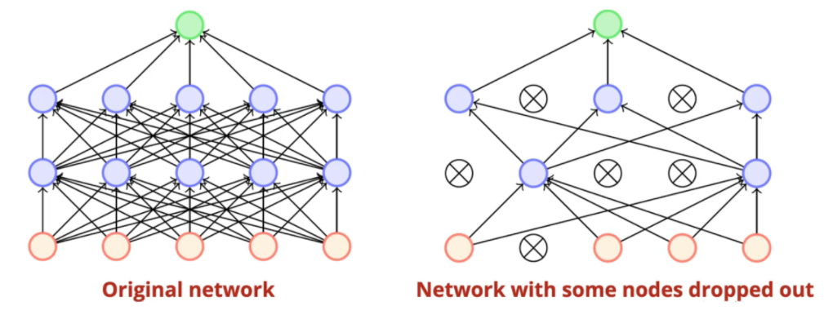

Dropout layer
Dropout is a regularization technique.
Randomly selected neurons are ignored during training.
Dropout reduces overfitting but requires extra computational training costs.
Notes:
שלב נוסף שאנחנו מבצעים הוא זריקה של חלק מתוצאות השכבה האחרונה, שלב זה נקרא DROPOUT והוא נעשה אחרי כל שכבה של קונבולוציה ומאקס פולינג אצלנו.
השלב הזה נעשה ע"י בחירה רנדומלית של אחוז מסוים מהנוירונים שאת ערכיהם נזרוק.
זריקה של חלק מהתוצאות עוזרת לנו במניעה של תופעת OVER FITTING שבה אנחנו מתמקדים ברזולוציה גבוהה מידי של מאפיינים באימון הרשת.

Slide 21
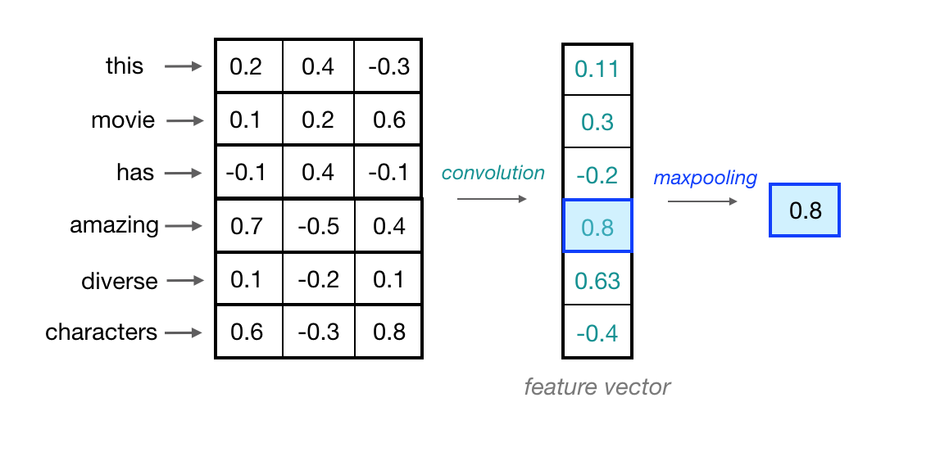

Max-Pooling layer
The Max-pooling layer decreases the dimension of the output obtained from the convolutional layer by retaining the maximum values in a feature vector, which should be the most useful local feature.
Notes:
בעזרת פעולת המאקס פולינג אנחנו יכולים לקבל ריכוז של מאפיינים במימד קטן יותר על מנת למקד את הרשת שלנו יותר בכל שלב.

Slide 22
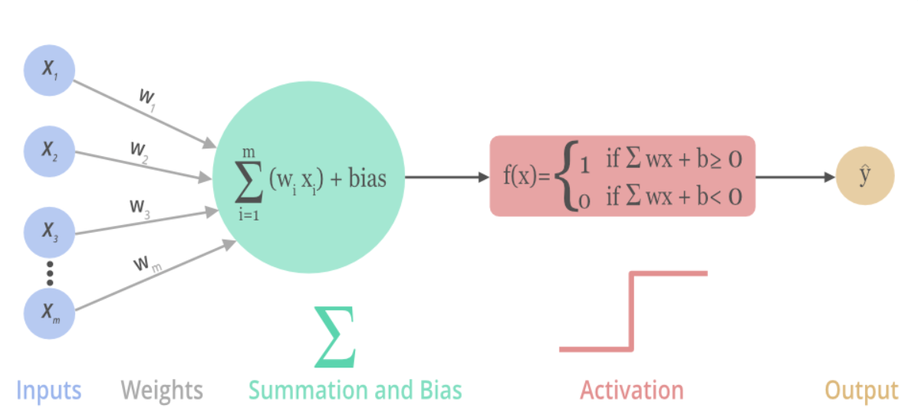
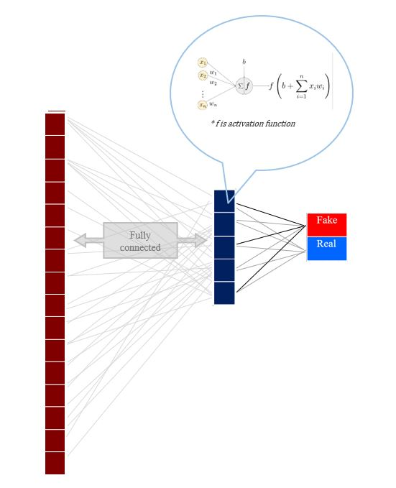

Dense layer
The fully connected layer is the most fundamental layer of neurons in a neural network.
Each neuron gets input from all neurons within the previous layer, processes it, thus densely connected .
Taking the inputs from the feature analysis and applies weights to predict the correct label.
Uses the activation functions (with weight & bias).
Notes:
השכבה האחרונה שאנחנו משתמשים בה אחראית לקחת את כל הפלטים מהשכבה האחרונה (MAX POOLING )ולחבר אותה ל4 נוירונים שהגדרנו.
הפלט שלנו בנוי מ4 נוירונים מכיוון שהמודל שלנו נותן חיזוי גם לאפשרות של לקשר אם תגובה היתה חיובית או שלילית בנוסף אם היא אמיתית או מזויפת.
לכן את כל הקומבינציות האפשריות.
השכבה הזו משתמשת בפונקציית softmax על הקלטים שהיא מקבלת.

Slide 23
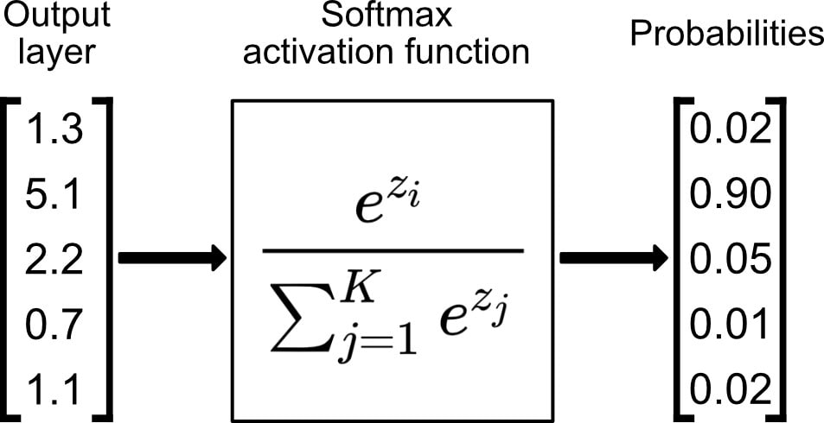
Activation Function
1. ReLU activation Function (Conv) 2. Softmax activation Function (Dense)
Notes:
בשכבות הקונבולוציה שלנו השתמשנו בRELU שכבר דיברנו עליה.
אך הפעם בשכבה האחרונה השתמשנו בSOFTMAX.
הפונקציה הזאת עובדת על ווקטורים, לכן נוכל לקחת את הווקטור שקיבלנו מהשכבה האחרונה וע"י הפעלת הפונקציה לקבל ווקטור שמכיל הסתברויות לכל תוצאה
כאשר הסכום שווה ל1.
The softmax function can be used in a classifier only when the classes are mutually exclusive.

Slide 24
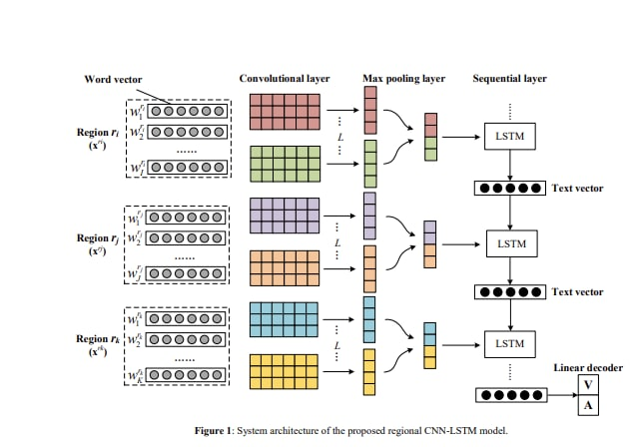

Notes:
באופן כללי, CNN מסוגל להפיק מידע מקומי אך עלול שלא להצליח לתפוס תלות למרחקים ארוכים. LSTM יכול לטפל במגבלה זו ברצף טקסטים על פני משפטים

Slide 25
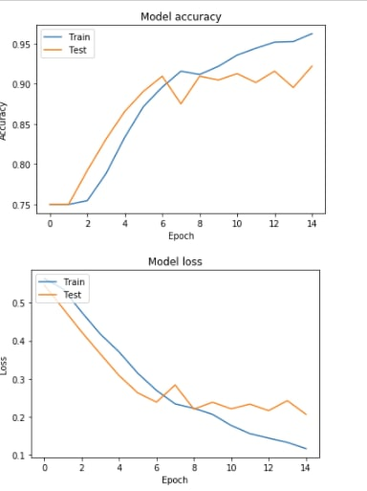
Model 3: CNN + Bi-LSTM using TF-IDF+Doc2Vec
Preparation:
Positive = 1, Negative = 0
Truthful = 1, Deceptive =0
Distinguish between the combinations as:
Positive and Truthful = TRUE_POSITIVE
Positive and Deceptive = FALSE_POSITIVE
Negative and Truthful = TRUE_NEGATIVE
negative and Deceptive = FALSE_NEGATIVE
Removing any words that don’t occur at least 5 times
Preprocessing and stemming (reducing all words to their roots playing->play) all reviews
Training a Doc2Vec model with the remaining words
Training and fitting TF-IDF vectors
Extracting training and testing datasets
Split to 90% training and 10% testing
Average the word vectors from both TF-IDF and Doc2Vec to be used during model fitting
Neural Network:
Sequential mode setup
Convolution (filters=128, kernel_size=9, relu)
Dropout (0.25)
MaxPooling (2)
Dropout (0.25)
Convolution (filters=128, kernel_size=7, relu)
Dropout (0.25)
MaxPooling (2)
Dropout (0.25)
Convolution (filters=128, kernel_size=5, relu)
Dropout (0.25)
Bidirectional LSTM (50, recurrent_dropout=0.2)
Dense (4, softmax)
Results:
loss: 0.2070 - accuracy: 0.9218
An additional 7.8% improvement.

Slide 26

Thank you

